Slide 1
Information Systems Management in the Global Economy
Chapter 1
Information Systems Management in Practice
8th Edition

Slide 2
Chapter 1–Outline & Objectives
Introduction
Themes of this Book
Management of IS
A Little History
The Organizational Environment
The External Business Environment
The Internal Organizational Environment
Goals of the New Work Environment

Slide 3
Chapter 1 cont’d
The Technology Environment
Hardware Trends
Software Trends
Data Trends
Communication Trends
The Mission of IS Organizations
A Simple Model

Slide 4
Chapter 1 cont’d
A Better Model
The Technologies
The Users
System Development and Delivery
IS Management
Organization of This Book

Slide 5
Introduction
Information technology (IT) is a pervasive element of society today and has revolutionized and restructured many aspects of human endeavor, including work.
This book emphasizes the use of IT in managing and operating organizations.

Slide 6
Themes of This Book
Globalization
Worldwide expansion of brands and the emergence of global institutions after World War II
American multinational enterprises’ foreign direct investments in other countries
IS organization must balance global IT enterprise goals with local systems needs
E-enablement
Leveraging of IT to build relationships with consumers and other enterprises in general

Slide 7
Themes of This Book cont’d
Business intelligence through knowledge sharing and knowledge management
Transfer of knowledge between people
Elicit tacit knowledge that people possess

Slide 8
Management of IS
Governance of IT
Collaborative effort between IS, the business and their constituencies
The Role of IS
System integration and infrastructure development
Outsourcing
Development and management of relationships with external service providers

Slide 9
A Little History
1950s: Calculator
Bookkeeping activities
Texas Instrument invented first handheld calculator
1960s: Mainframe
Data-intensive business transactions and accounting
IBM mainframe

Slide 10
A Little History cont’d
1970s: Database management systems
Operational efficiency
Structured Query Language (SQL) first developed by IBM
Oracle and SAP emerged as key players
1980s: Personal Computer (PC), decision support systems
Office automation (OA) and decision-making
IBM released first PC (hardware) with Microsoft MS-DOS operating system (software)

Slide 11
A Little History cont’d
1990s: Internet and Enterprise Resource Planning
Global communication and exponential growth in use of computers for OA and networking
Microsoft Windows and Office Suite
Email, instant messaging, World Wide Web
2000s: Internet and Social Fabric
Global coordination and cooperation (strategic partnerships) within and between businesses
Web services, e-supply chains
Social computing for business applications

Slide 12
A Little History

Slide 13
The Organizational Environment
External forces that cause IS executives to re-examine how their firms compete and internal structural forces that affect how organizations operate or are managed.
External business environment
Internal organizational environment
Goal of new work environment

Slide 14
The External Business Environment
Internet economy
IT underpins old and new ways of doing business
Physical and electronic marketplace
Global Marketplace
Internet has accelerated firms’ internationalization process
Born global
Micro-markets
Micro-commoditization and micro-consumption
Digital microproducts
iTunes, Amazon shorts, Disney short videos
Business ecosystems
Relationships and growth that are organic in nature

Slide 15
The External Business Environment cont’d
Decapitalization
Emphasis on intangible assets
Faster business cycles
First-mover advantage
Instant gratification
Accountability and transparency
IT’s role in corporate governance
Rising societal risks of IT
Job losses due to technology substitution and outsourcing
Information security

Slide 16
The Internal Business Environment
From supply-push to demand-pull
Customer-centric philosophy
Value co-creation with customer
IT allows business to achieve this on a large scale
Self-service
Customer empowerment (through customization)
Customers know what they want best
Real-time working
Derive competitive advantage
Team-based working
For the duration of projects and tasks (ephemeral)

Slide 17
The Internal Business Environment cont’d
Anytime, anyplace information work
Tele-work, mobile computing
Outsourcing and strategic alliances
Use of IT to help manage work across the extended enterprise
Demise of hierarchy
Flatter organization (employee empowerment)
Use of IT to facilitate information exchange

Slide 18
Business Strategies in the New Work Environment
Leverage knowledge globally
Tap into intellectual capital across the entire enterprise
McKinsey’s
Organize for complexity
Interconnectivity and interdependence of businesses
Work electronically
Concept of the workspace
Handle continuous and discontinuous change
Built to change (innovation)
Total quality management (continuous)
Reengineering (discontinuous)

Slide 19
The Technology Environment
The technological (IT) environment has a symbiotic relationship with organizational structure (co-evolution)
Hardware Trends
Software trends
Data trends
Communication trends

Slide 20
Hardware Trends
Movement of central administration to distributed computing
1950s and 1960s (mainframe)
Mainframe, batch-processing, back-end data centers
1970s (minicomputer)
Some autonomy at the department level
1980s and early 1990s (personal computer)
PCs greatly accelerated process of decentralization
Client-server model
Late 1990s and 2000s (Web, networks and mobile/handheld)
Centralized computing via networks and the Internet

Slide 21
Software Trends
Transaction processing application development
Emphasis on improving productivity of programmers
Life cycle development methodology
Focus on rigorous project management techniques
Purchased software vs. in-house development
“Programming” shifted to end-users
Point-and-click applications
Open systems software vs. proprietary software
Enterprise resource planning (ERP) systems
Web services—service oriented architecture (SOA)
Network centric and loosely coupled applications to support business process requirements

Slide 22
Data Trends
1970s: Technical solutions for managing data
Database management systems (DBMS)
Centralized environment for first 20 years
1990s: Shift toward managing information resources
Concepts/ideas as a function of raw data
Voice, video, graphics, animation
Decentralized environment of information access and exchange (end-user level)
Require data warehousing and data mining technologies
2000s: Web content management
Standardize formats of and make interoperable huge amounts of data on Web sites
e.g., Extensible Markup Language (XML)

Slide 23
Communications Trends
1980s: Enterprise networking
Local area networks (LAN) within organization site
Wide area networks (WAN) between organization sites
Private leased lines
1990s onwards: Internet (convergence of telecommunications and information systems)
Invention of modulator/demodulator (MODEM)
Dialup, ISDN and other broadband technologies to solve problem of last mile
Internet protocols (TCP/IP) became de facto standard for LANs and WANs
Voice over IP
Wireless technologies

Slide 24
The Mission of IS Organizations
Transaction processing systems (TPS) in the early days
“Paper factories”
MIS era
Producing reports for all levels of management
Today’s context
Improve the performance and innovativeness of people in the organization using IT
Business results as a metric for IS performance

Slide 25
A Simple Model
IS functions in organizations
Figure 1-2 represents the process of applying IT to accomplish useful work
Figure 1-3 describes the increasing power and complexity of IT
More specialization required of IS professionals
Figure 1-4 depicts the increasing IT sophistication and efficacy of users

Slide 26
A Simple Model cont’d

Slide 27
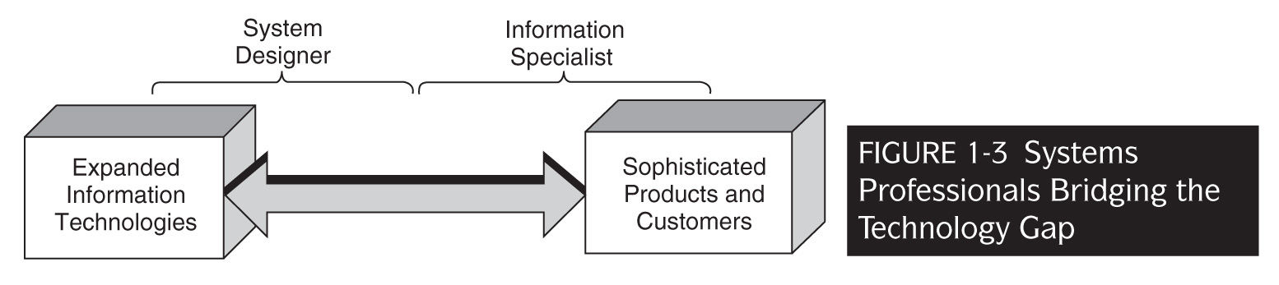
A Simple Model cont’d

Slide 28
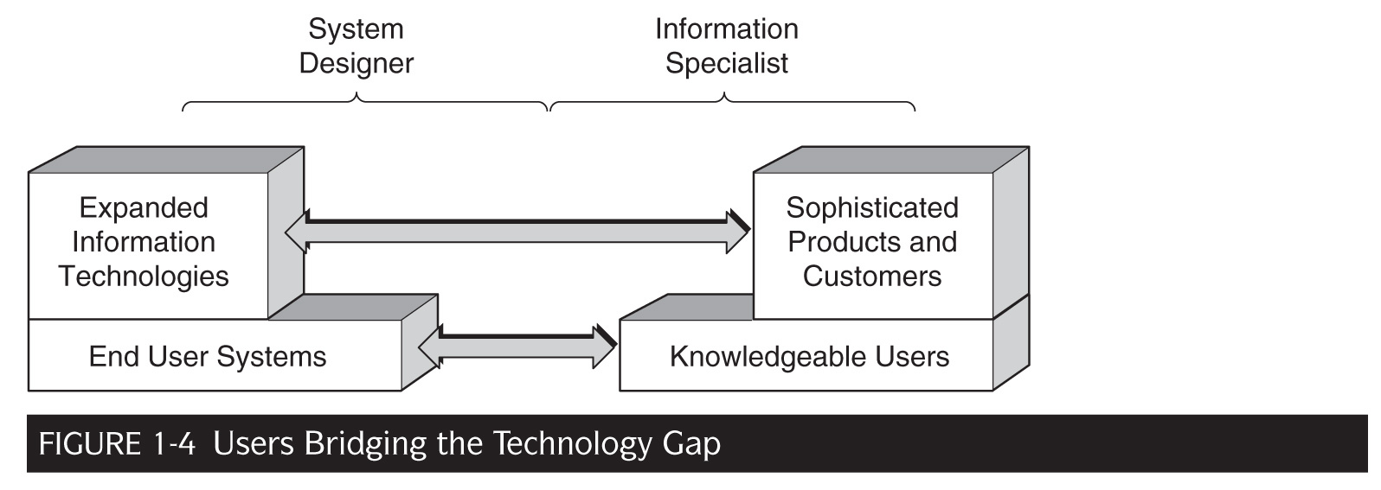
A Simple Model cont’d

Slide 29
A Better Model
An expanded model with four principal elements to describe IS function
A set of technologies that represent the IT infrastructure installed and managed by the IS department
Web services, mobile applications, integration of multimedia and consumer electronics
A set of users who need to use IT to improve their job performance (Figure 1-5)
Support procedure-based activities
Support knowledge-based activities

Slide 30
A Better Model cont’d

Slide 31
A Better Model cont’d
A delivery mechanism for developing, delivering and installing applications
Bridging the gap between technology and users (Figure 1-6)
Executive leadership to manage the entire process of applying the technology to achieve organizational objectives and goals
Executive team must work together to govern and leverage IT well
C-level executives, divisional and department heads

Slide 32
A Better Model cont’d

Slide 33
Organization of This Book
Part 1: Leadership
Chapters 2 - 4
Strategic issues that are the responsibility of the CIO
Chapter 2: Evolution of IS function and CIO’s job
Chapter 3: Strategic uses of IT
Chapter 4: IS planning

Slide 34
Organization of This Book cont’d
Part 2: Technologies
Chapters 5 - 8
Management of the essential information technologies
Chapter 5: Distributed systems architecture
Chapter 6: Building and managing telecommunications
Chapter 7: Managing corporate information resources
Chapter 8: Managing day-to-day operations

Slide 35
Organization of This Book cont’d
Part 3: Developing and delivering systems
Chapters 9 - 11
Developing and delivering primarily procedure-based systems
Chapter 9: Evolution of system development, and the tools and approaches
Chapter 10: Issues in system development and delivery
Chapter 11: Information security

Slide 36
Organization of This Book cont’d
Part 4: Supporting Work
Chapters 12 - 14
Different types of information systems that support work
Chapter 12: Supporting decision-making
Chapter 13: Supporting collaboration
Chapter 14: Supporting knowledge work
Part 5: Thinking ahead
Chapter 15
Projects the role of IT in the future

Slide 37
MeadWestvaco Corporation
Case Example: Structure and evolution of IS in an organization
1960s and 1970s
Reorganization of information services
1980s
Focus on end-user computing
Late 1980s
Structure adjustment
1990s
A new strategy to leverage the IT infrastructure
2000s
New organizational structure to enable technology integration and creation of a global, process-based, business-driven organization

Slide 38
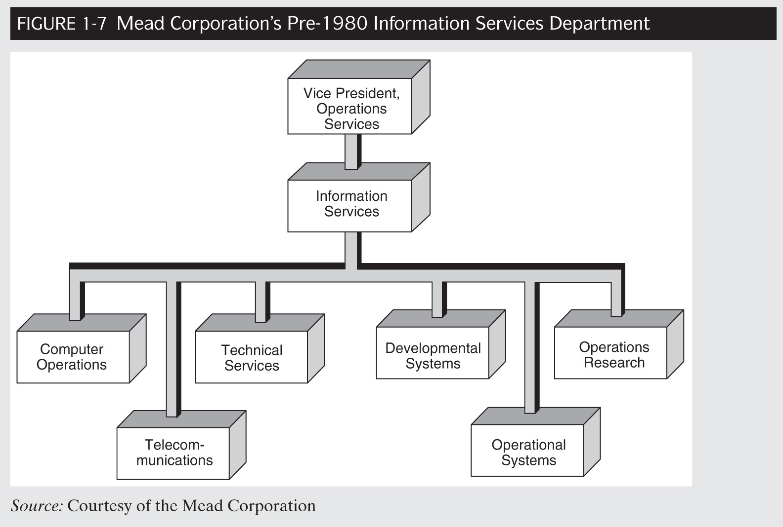
MeadWestvaco Corporation

Slide 39
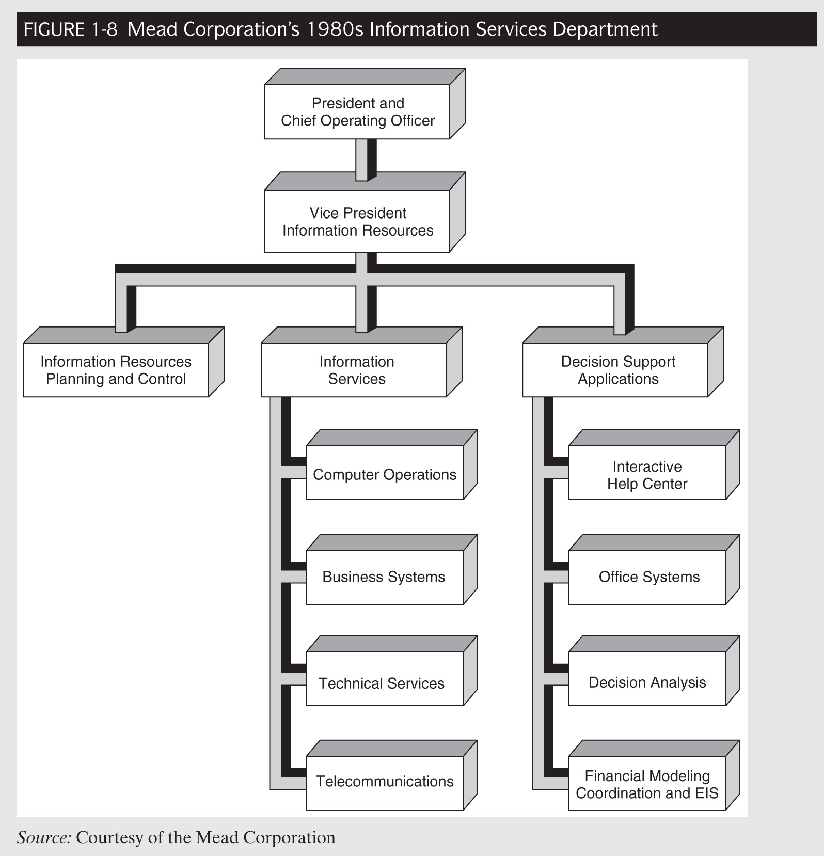
MeadWestvaco Corporation

Slide 40
MeadWestvaco Corporation cont’d
Case Example: Structure and evolution of IS in an organization
Into the 2000s
Leverage centralization
Governance structure and standardization
2004
Creating the process-based, business-driven EIS organization

Slide 41
The Top IS Job
Chapter 2
Information Systems Management in Practice
8th Edition

Slide 42
Today’s Lecture
Introduction
Where is the IS organization headed?
The escalating benefits of information technology
Traditional functions are being “nibbled away”
New roles are emerging
Toward “IS Lite”

Slide 43
Today’s Lecture cont’d
The CIO’s responsibilities
CIO’s roles in 3 eras
Leading
Creating a vision by understanding the business
Governing
Establishing an IS Governance Structure
Investing
Shaping the IT portfolio
Managing
Establishing credibility and fostering change

Slide 44
Today’s Lecture cont’d
The Office of the CIO
Whither CIOs
Conclusion
Questions and Exercises
References

Slide 45
Introduction
Growing demand for IT managers in the U.S. and worldwide.
Management of IT in past 50 years has drastically changed.
Basic functioning → cost reduction → decision support → inter-organizational supply-chain and “business eco-system”
Onus on top executives to provide IT vision and leadership.

Slide 46
Where is the IS organization headed?

Slide 47
Escalating Benefits of IT
Changing technology and evolving IS role since 1950s. (a parallel process)
“Waves of Innovation”:
Wave 1: Reducing costs
Wave 2: Leveraging investments (continuous improvement)
Wave 3: Enhancing products and services
Wave 4: Enhancing executive decision-making
Wave 5: Reaching the consumer
Wave 6 (new): Leveraging partnerships through supply chain management or other forms of collaboration

Slide 48
Escalating Benefits of IT (cont’d)

Slide 49
The SABRE System (American Airlines)
Case example of “Waves of Innovation”
Evolution: Handwritten reservation system (1950s) to Web-based system (2000s).
Waves 1 and 2 (1960s)
SABRE (CRS) built to reduce costs of making airline seat reservations.
ROI on staff expenditure.
Wave 3 (1970s)
System enhanced to span organizational boundary for travel agents (provide direct access to CRS)

Slide 50
The SABRE System (American Airlines) cont’d
Wave 4 (late 1980s)
Revenue Management System (provide decision support to managers) under SABRE Airline Solutions (new division).
Wave 5 (1990s)
System extended to provide direct Web access to customers (CRS, flight information, movie etc.)
Wave 6 (2000s)
Sabre (small letters) spun off from AMR in 2000, leveraged partnerships and technology.

Slide 51
The SABRE System (American Airlines) cont’d
Throughout waves of innovation, strong IS involvement was crucial.
Evolving with changes in technology
From money-making to extending organizational boundaries to spinning off.
So what is the function of the IS organization?

Slide 52
Traditional Functions are Being Nibbled Away
Traditional set of responsibilities for IS
Managing operations of data centers, local and remote systems and networks
Managing corporate data and legacy systems
Performing system analysis and design and constructing new systems
Planning and integration of systems
Identifying opportunities for new systems

Slide 53
Traditional Functions are Being Nibbled Away cont’d
Trends that are moving traditional roles out of IS:
Distributed Systems
Migration of software applications to user areas
Ever more knowledgable users
Better application packages
Systems development to integration
Outsourcing
Based on fiscal and managerial considerations

Slide 54
Traditional Functions are Being Nibbled Away cont’d

Slide 55
New Roles are Emerging
IS involves a cluster of functions:
Run operations
Develop systems
Develop architecture
Identify business requirements
Create IT-enabled innovations

Slide 56
New Roles are Emerging cont’d
Different set of skills and management strategy needed for each function:
Maximize efficiencies of IT operations
Better allocation of IT personnel time
Prioritize resources to demonstrate usefulness of new software projects
IT-enabled business innovations

Slide 57
New Roles are Emerging cont’d

Slide 58
Toward IS Lite
IS started “centralized” and then evolved into “federal” model.
Some things (e.g standards, operations) centralized
Others (e.g. applications development) dispersed to best meet local needs.
Solution: shift attention from roles to processes
IS Lite: managing three overall processes
Driving innovation (dispersed)
Managing change (dispersed)
Supporting infrastructure (centralized)

Slide 59
Toward IS Lite

Slide 60
LifeScan
Case example: The “Federal” Model
Johnson and Johnson subsidiary
New CIO with business-IS alignment agenda
3-stage framework that is focused on execution and performance measurement (value, on time, budget)
Notes:
Stage 1: backend (supporting infrastructure)
Stage 2: start working with business units (change, innovation etc.); value measured by business units e.g. business score cards.
Stage 3: melding of business units and IS; value measured by firm performance

Slide 61
LifeScan cont’d
Strong project management, not allowing scope creep (business value, on time, within budget)
Emphasis on staff with leadership and brokering skills
Outsourcing (Tata, J&J outsourcing agreements)
Adopt J&J quality-driven culture into IS processes and working closely with business units for alignment every step of the way.
Centralization of policies, procedures etc.
All IS projects business led and locally owned by business units.

Slide 62
The CIO’s Responsibilities
Evolution of CIO’s job emphasis over last 20 years
Almost like a “bell curve”
80s: Chief architect (strategic use of IT)
90s: addressing business issues (more than technology manager)
Late 90s to early 2000s (forefront role)
Mid 2000s onwards: slide back toward back seat--more responsibilities, lots of justification and less $

Slide 63
CIO Roles in Three Eras
Notes:
Jeanne Ross (MIT) and David Feeny (Oxford)

Slide 64
CIO Roles in Three Eras
The Mainframe Era
Predominated 1960s – early ’80s
Role of DP / IS manager = operational manager of a specialist function
Distributed Era
In the ’80s as PCs become commonplace
LANs and WANs linking computers
Took on 4 more roles:
Organizational designer
Technology advisor
Technology architect
Informed buyer

Slide 65
CIO Roles in Three Eras
The Web Era
Started in the mid-1990s for some
Arose from the emergence of the Internet (especially WWW) as a business tool
Era is still in “infancy” but add to the CIOs job, the role of business visionary
Relationship between CEO and CIO vary along a wide spectrum.

Slide 66
CIO Roles Today
Leading
Creating vision by understanding the business
Governing
Establishing an IS governance structure
Investing
Shaping the IT portfolio
Managing
Establishing credibility, managing IT functions, and fostering change

Slide 67
Leading: Creating vision by understanding the business
Understanding the business
Encourage project teams to study the marketplace
Concentrate on lines of business
Sponsor weekly briefings
Attend industry meetings with line executives
Read industry publications
Hold informal listening sessions
Partner with a line executive

Slide 68
Leading: Creating vision by understanding the business

Slide 69
Leading: Creating vision by understanding the business
Creating a vision of the future and selling it
CIO must be proactive and not simply reactive
A leader not a follower
What is a vision?
Statement of perceived future
Why develop a vision?
A vision of a desirable future can provide stability when it sets a direction for an organization
Selling the vision

Slide 70
British Petroleum (BP)
Case example of creating a vision of the future and selling it
150 business units in 100 countries
Each with own balance sheet and performance criteria
Need to reconcile business unit independence with overarching HQ strategy (“speed matters”)
Strong core values and operational excellence
How can IT be a value-add?

Slide 71
British Petroleum (BP)
John Leggate’s “Digital Business” vision.
Technology provider to strategy-creation role
Strategy, architecture, differentiated services based on business streams (processes)
Living on the Web
Socializing technical directions (adoption)
Going forward: Foster learning and focus on explanation (assimilation)

Slide 72
Leading: Creating vision by understanding the business
Creating a vision of the future and selling it (cont’d)
Encouraging champions of IT projects
“Boundary-spanner-in-practice”
Typically someone with authority
Need information
Need resources
Need support
Notes:
Champion: someone (outside of department) with a vision who gets it implemented by obtaining the funding, pushing project over hurdles, putting his or her reputation on the line, and taking on the project risks.
Boundary spanner: suitable for business processes and streams

Slide 73
Aetna Life and Casualty
Case example of creating a vision of the future and selling it
Vision: “breakthrough technologies”
Sought out business champions
Pilot studies
Feedback for new technologies experimentation
Steering Committees
Challenges
Adoption (attention and use)
Value (beyond piecemeal payoffs)

Slide 74
Governing: Establishing an IS governance structure
Definition: IS Governance
“The assignment of decision rights and the accountability framework to encourage behavior in the use of IT.” (Weill & Woodham, 2002)
Governance versus management
Governance is about deciding who makes decisions.
Management is about making decisions once decision rights have been assigned.

Slide 75
Governing: Establishing an IS governance structure
Importance of corporate IT governance
Large and diverse IT assets
Striking a balance between global and local needs
IT portfolio (in sync with business needs)
Assigning decision rights
Governance style
Definition: who has a decision right and input right.
Six governance styles

Slide 76
Governing: Establishing an IS governance structure

Slide 77
Duke Energy International
Case example of IS governance
Diverse portfolio of natural gas and electric supply, delivery and trading businesses.
CIO: “When am I free to decide on my own versus when should I involve others?”
I involve others if the consequences of my actions will come to bear on those others.
I do not involve others if the consequences of my actions will come to bear just on me.
I inform others when the consequences of my actions will be of benefit to others.

Slide 78
Investing: Shaping the IT Portfolio
Diminishing marginal increase today but still preposterous amount of IT investments.
Two perspectives in IT investment:
Strategic view
What to invest in?
Tactical view
How to make investment decisions?

Slide 79
Investing: Shaping the IT Portfolio
A Strategic view of making IT investments
McKinsey Global Institute study of “new economy”
IT, competition, innovation and productivity in virtuous circle
Targeting IT investments
Prioritizing on “levers that matter” = greatest productivity
Timing of IT investments
Based on company needs and goals

Slide 80
Investing: Shaping the IT Portfolio cont’d

Slide 81
Investing: Shaping the IT Portfolio
Sequencing of IT investments
Wal-mart versus Kmart case example
Complementing IT investments
“The whole is not the sum of its parts” (synergy)
Complementarities between management practices, business processes and technology

Slide 82
Wal-mart versus Kmart
Case example: Sequencing and timing IT investments
Wal-mart
Step 1: installed systems to automate the flow of products in its internal supply chain
Step 2: turned outward to suppliers, coordinating its own operations with theirs
Step 3: turned to customers to better plan its merchandising mix and replenishment
Step 4: data warehouse

Slide 83
Wal-mart versus Kmart
Kmart
Mistake: used IT to target its marketing promotions versus investing in supply chain
Result: increase in demand from successful promotions could not be met due to problems getting the products into stores in a timely fashion.
Result: lost sales and revenues

Slide 84
Investing: Shaping the IT Porfolio cont’d
A tactical view of making IT investments
Portfolio (holistic) approach to deciding on how to make IT investment decisions.
Numerous approaches to prioritizing
Business Scorecards
80-20 Principle
Cost-Benefit analysis (CBA)
Net Present Value (NPV)

Slide 85
AXA Financial
Case example of tactical view of making IT investments
French global financial services organization with 140,000 employees and managing $795 billion in assets.
New governance methodology (beyond IT)
Economics-informed investments (precludes emotional attachment or other non-financial factors)
Modeled after fund management
Governance committee involve all C-level executives

Slide 86
Investing: Shaping the IT Portfolio cont’d
Benefits from Discussions
Categorizing projects for comparisons
Address project risks
Prioritize quarterly and apportion your budget accordingly
Consistency (team decision-making)

Slide 87
Managing: Establishing Credibility and Fostering Change
CIOs must first establish credibility in IS before change can come about.
Establishing Credibility
Focus first and foremost on the “today” even before talking about the “tomorrow”
Deliver value-added, quality services
First impression matters

Slide 88
Managing: Establishing Credibility and Fostering Change
Fostering Change
Technical aspects only half the battle
Emphasis on change management
Changing the way people work, bringing it to the next level
Disruptive to current work practices
Leads to resistance
Methodologies to implement IT-enabled change

Slide 89
Managing: Establishing Credibility and Fostering Change
Working across organizational lines
CIOs now find that systems they implement affect people outside their firm boundaries
Arms-length to more cordial relationship with partners (suppliers and customers)
Change need buy-in from these external stakeholders

Slide 90
REXAM
Case example of working across organizational lines
One of the world’s top 5 consumer packaging companies and the world’s top drink can maker
Rethinking interactions with customers (B2B)
Leverage Internet to deliver “exceptional service”
“Knock their socks off”
Result: cash flow improvements, barriers to switching, profit increase

Slide 91
REXAM cont’d
CIO’s role
External and business-oriented
Convincing existing customers and business development
Steering Committee’s role
Firm-wide commitment from C-level executives for expanded e-business initiatives envisioned by CIO.
Online catalogue

Slide 92
The Office of the CIO
Chief Information Officer (CIO)
Top management, customers, suppliers
Chief Technology Officer (CTO)
IT planning, architecture, new technologies
Chief Operations Officer (COO)
Daily IS operations
Chief Project Officer (CPO)
Projects management

Slide 93
Conclusion: Recap
Why does the IS organization exist?
Constant factor in parallel process of technological changes and IS evolution
What is the role of the IS organization?
Changing across the timeline toward IS Lite
CIO’s job
How does the IS organization perform its job
Strategies

Slide 94
Strategic Uses of Information Technology
Chapter 3
Information Systems Management in Practice
8th Edition

Slide 95
Chapter 3
The Internet provides a better technological platform than previous generations of IT (Porter, 2001, 2008).
Questions that remain:
Has the Internet or more generally, the IT revolution ended? Does IT still matter?
Is there an even larger revolution looming?
Is Web 2.0 really something new or just another fad?
What sorts of strategic uses of IT are companies making?

Slide 96
Today’s Lecture
Introduction
History of Strategic Uses of IT
Whither the Internet Revolution
The Cheap Revolution
Episode Two: Profitability Strikes Back
Episode Three: Internet-Enabled Mass Customization
Working Inward: Business-To-Employee
Building an Intranet
Fostering A Sense of Belonging

Slide 97
Today’s Lecture cont’d
Working Outward: Business-To-Customer
The Emergence of Electronic Traders
Getting Closer to Customers
Being an Online Customer
Working Across: Business-To-Business
Coordinating with Suppliers
Establishing Close and Tight Relationships
Becoming a Customer-Centric Value Chain
Getting Back Systems in Shape
Conclusion

Slide 98
Introduction
Use of the Internet by businesses in mid/late 1990s set off a revolution in the use of IT
No successful modern organization can separate IT from its business strategy?
After dot com bust, Moore’s Law, declining price of computing…
Does IT still matter?
If yes, what are the strategic uses of IT (particularly Internet) today?

Slide 99
History of Strategic Uses of IT
Mid 1980s: End-user computing
Working inward (adoption of PCs and software)
Late 1980s: Transactional efficiency
Working outward (gain competitive advantage)
Merrill Lynch’s CMA system, which combined stock account with savings and checking accounts
1990s: Re-engineering
Working inward (business process re-engineering)

Slide 100
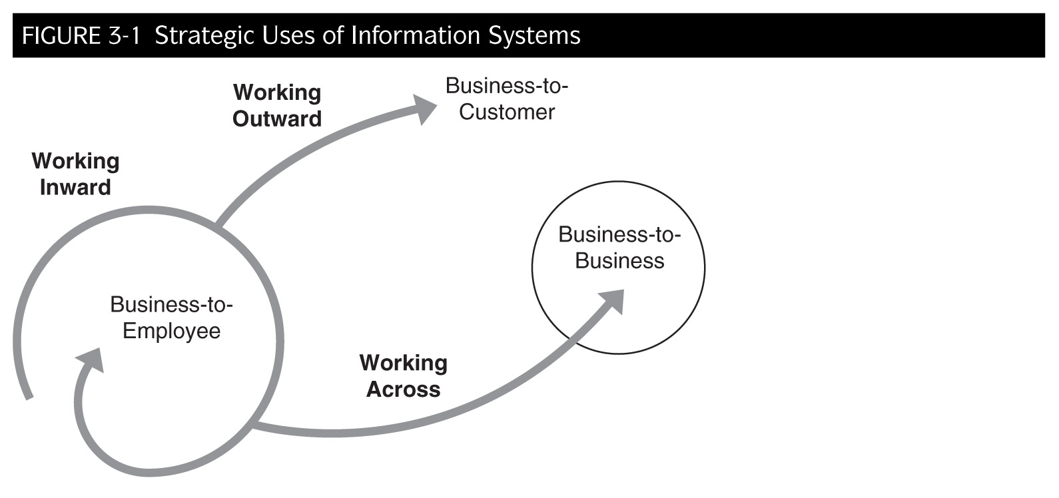
Strategic Uses of Information Systems

Slide 101
History of Strategic Uses of IT cont’d
Mid to late 1990s: Internet
Integration of Internet into e-business models
Dotcom downward spiral began in 1999
E-business skepticism
Early 2000s: Back to business basics
Leverage traditional operations by using Internet to work more closely with others (working across)
2005 onwards:
Working inwards, outwards and across to achieve competitive advantage
2008: Putting IT in the forefront of business strategy

Slide 102
Whither the Internet Revolution?
Despite dot com bust in 2001, Internet technology is more pervasive
Wikis, blogs, instant messaging
Arrangements of Internet use is key
Internet-driven business innovations
Interconnection of businesses will be the revolution?

Slide 103
The Cheap and Disruptive Revolution
CIOs are shifting from buying expensive proprietary hardware to cheap generic products
Google runs on 100,000 cheap servers
Use it till it breaks and then discard (no maintenance)
Other aspects of “cheap”
Labor outsourcing
Free open-source software vs. expensive proprietary products
Telecommunications (e.g., VoIP)

Slide 104
Episode Two: Profitability Strikes Back
Never ignore business strategy
Leveraging Internet to increase business value proposition
Use Internet to complement business strategy (core competencies) and not replace it (Michael Porter, Strategy and the Internet)
Focus on building profitability instead of pursuing market share (customers) indiscriminately
MyFace.com still figuring out how to make money from 60 million plus members worldwide (Businessweek, March 10, 2008)

Slide 105
Episode Three: Internet-Enabled Mass Customization
Internet has changed the nature of consumerism (“long-tail” phenomenon)
Shift from concentration of small number of mainstream products and markets to large number of previously unattended niches
Less need to offer one-size-fits-all products and services
Mass-customization and even personalization is the future
e.g., Apple iTunes, mobile phone applets, YouTube videos

Slide 106
Grainger
Case Example: Using Internet to complement your strategy
Distributor of all sorts of non-production products (800,000) to companies in the U.S.
Customers who purchase online also purchase through traditional channels
Physical sites make online presence more valuable
Fast delivery
Continue publishing paper catalogue
Receives surge of online orders each issue of new paper catalog

Slide 107
Episode One Revisited:
Is rapid growth strategy of dot coms during 1993-2000 period necessarily a bad one?
First-mover advantage crucial since IT innovation is short-lived (Carr, 2004) to achieve other sources of competitive advantage
Internet facilitates accelerated online business growth
Wide access to a public network
Standard communication protocol
Standard user interface
Achieve growth and market share then seek profitability or vice versa (traditional)?

Slide 108
Does IT Still Matter?
Nicholas Carr: IT a utility (like electricity)
Ubiquitous
No sustainable competitive advantage
Proponents: IT enables innovation, segmentation and differentiation
IT systems (software) infinitely configurable
Creativity
Management quality

Slide 109
Working Inward: Business-to-Employee
Building an Intranet
Intranets are private company networks that use Internet technologies and protocols to reach employees
Benefits of Intranet
More efficient and cost-effective way to provide access to company information
24/7 availability, dummy-proof browser interface, easier development and less maintenance ($), faster updates, information integrity

Slide 110
Intranet Architecture

Slide 111
GE Energy Power Systems
Case Example: Building an Intranet
Internal survey
Sales force spending more time in office (searching for information) than outside with their customers
Built Web-based sales portal
Internal data
Sales, parts, pricing, inventory, customers etc.
News feed from outside
Single point of entry
Information always current

Slide 112
Working Inward: Business to Employee cont’d
Fostering a sense of belonging
Intranets evolving into very important enterprise structure
Corporate mission and values
Internal forms, rules, processes
Internal news (can be interactive, e.g. comments)
Intranets can provide the foundation for creating corporate culture and climate by giving a means for communication and creating communities

Slide 113
Working Outward: Business-To-Customer
Modern enterprises today need sophisticated computer systems to compete
Quality, service, innovation, speed
Competitors must do the same or find themselves at a disadvantage
Two Business-to-Customer strategic IT uses:
Jumping to a New Experience Curve
The Emergence of Electronic Tenders

Slide 114
Jumping To A New Experience Curve
Using IT (or any technology) as the basis for a product or service can be viewed as moving across a series of experience curves
More experience leads to a set of connected curves
Each curve represents a new technology or combination thereof in a product or service as well as in its manufacture or support
Moving to a new curve requires substantial investment in a new technology

Slide 115
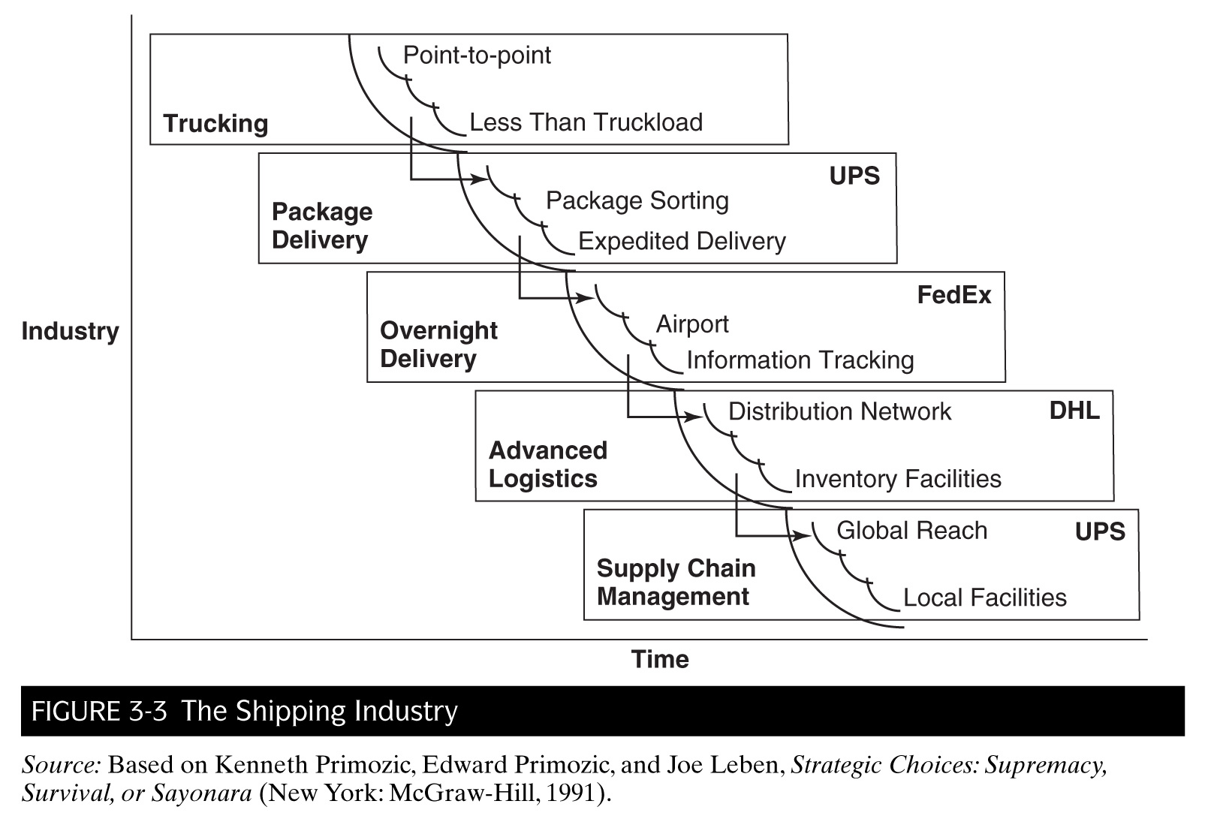
Shipping Industry Case Example: Jumping to a new experience curve

Slide 116
Cisco Systems and UPS
Case Example: Jumping to a new experience curve
In the late 1990s, Cisco committed to manufacturing products within two weeks of order.
Problem: Could not guarantee delivery, especially for European customers
Turned over European supply chain to UPS
UPS handles shipment of the package all the way from the U.S. to the customer in Europe.
Successful cooperation due to linking and synchronizing both companies tracking systems
UPS handled over 1million boxes a year
Cisco could thus promise delivery times to European customers

Slide 117
The Emergence of “Electronic Tenders”
An electronic tender is the capability to monitor a product or service using computers.
e.g. car diagnostics, package tracking, customer interactions
The options for electronic tenders are endless, but the main objective is to get closer to the customer.

Slide 118
Getting Closer to Customers
Many types of products can be purchased on the Internet today.
Advantages to selling online are numerous
Track, analyze and act on customer data (CRM)
Access to global markets
Many corresponding problems at the same time
Customer privacy issues
Customers demand “now” and personalized services
Information (company, product, price), order processing, single point of contact, customization
Reduction in search costs puts burden on profit margins

Slide 119
Advantages to Business-to-Customer System

Slide 120
Problems to Business-to-Customer Systems

Slide 121
TerenceNet: A Day in the Life of an E-Lancer
Case Example: Being an Online Customer
TerenceNet an online consulting firm for SMEs
Staff use online services (at 10% commission) of Elance (www.elance.com)
Bid for projects
Chat with potential clients
Sub-contract projects to others (become a client)
Signing up on Elance is like joining a community
Forming relationships with clients, employers, other bidders, and people-at-large

Slide 122
Working Across: Business-to-Business
Streamlining processes that span across company boundaries is the next big management challenge
Taking efficiency to the inter-organizational level
Numerous forms of working across businesses
Coordinating with co-suppliers
Working with customers in close mutually dependent relationship
Building a virtual enterprise that might evolve into an e-marketplace

Slide 123
Coordinating With Co-Suppliers
Collaborating with non-competitors is a type of working across
E.g. Two manufacturers might have the same customers but supply different products
Internet-based systems enable co-suppliers to share information and work together
Collaborate on new joint processes
Eliminate duplicate activities
Optimize work allocation (who can do it best)
Focus on customers

Slide 124
General Mills and Land O’ Lakes
Case Example: Coordinating with co-suppliers
7 largest U.S. food companies
Supply 40% of supermarket shelf space for dry goods
Justification to each support own fleet of delivery trucks
Supply only 15% of refrigerated goods
Quantity insufficient—only 1 truck for each company to delivery to several supermarkets (inefficient)
General Mills and Land O’ Lakes combined trucking deliveries
Achieved efficiency and higher supermarket satisfaction
Working on integrating order-taking and billing processes

Slide 125
Establishing Close and Tight Relationships
Building relationships with various players in one’s business ecosystem is the current strategic objective for use of IT and the Internet
Banks, advertising agencies, suppliers, distributors, retailers, competitors
Relationships as a function of linking information systems

Slide 126
Establishing Close and Tight Relationships
Need to determine what level of systems integration
Loose: Provide ad hoc and limited access to internal information
Business processes remain distinct
Low risks and costs
Close: Two parties exchange information in a formal manner
More incentives and thus impetus to ensure success
Moderate risks (sharing confidentialities) and costs
Tight: Tow parties share at least one business process
Business critical
High risks and costs (requires integration)
Boundaries become blurred

Slide 127
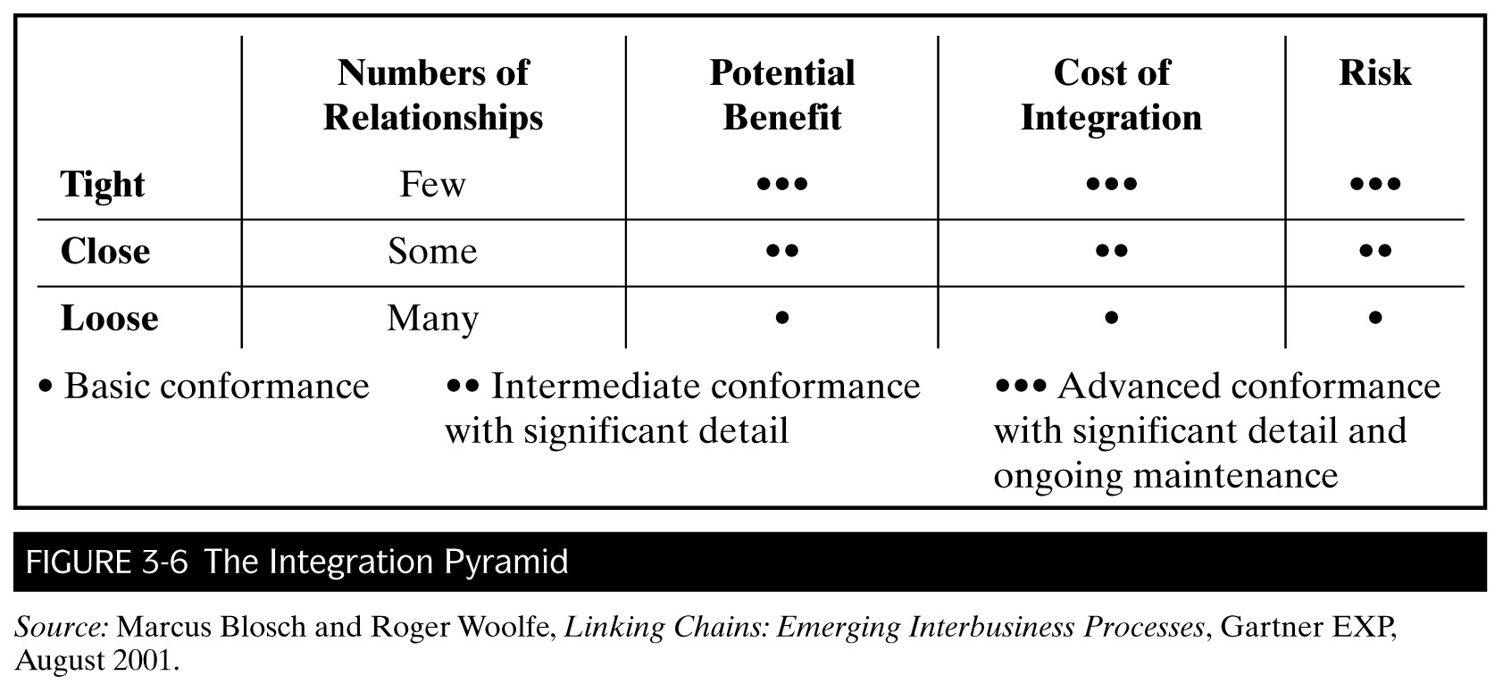
Linking Chains: Emerging Interbusiness Processes

Slide 128
Sara Lee Bakery Group (SLBG)
Case Example: Close relationship becoming a tight one
SLBG introduced scan-based trading (SBT)— selling on consignment
Scan data of SLBG products sold at retailers transmitted to SLBG directly via EDI/Internet or indirectly through third-party, to process billing
Technology improved quality of work for delivery people, reduced costs, and increased revenues
Administration
7 prerequisites for creating SBT relationships
Management structure to support SBT

Slide 129
Becoming a Customer-Centric Value Chain
Value chain (manufacturing-based model)
Upstream supply chain
Suppliers of raw materials
Downstream demand chain
Distributors, retailers, customers
Push (supply) and pull (demand) marketing strategies
Demand-pull model favored today—value chain starts from the customer
Benefits and drawbacks
Efficiency, customer satisfaction, trust, infrastructure

Slide 130
Dell versus H.P.
Case Example: Customer-Centric Value Chain
Dell’s demand-pull model
Customers configure their PCs and notebooks on Dell’s Web site and make the order (payment)
Ordering information and production schedule automatically transmitted to OEM suppliers via Dell’s extranet (private exchange system)
H.P.’s pull + push model
In addition to online channel, H.P. uses major retailers to sell its computers
Customers can buy computers immediately after trying them out at stores (instant gratification)
H.P. displaced Dell’s leader market position in 2006

Slide 131
Getting Back-End Systems in Shape
B2B systems must integrate with existing back-end systems
Challenge
Wide variety of functions and platforms
Incompatibility
Approach
Purchase new systems that facilitate integration
DBMS, ERP
Extranet
Goal
Extend company’s back systems to re-engineer business processes external to the company

Slide 132
Conclusion
Many “best practices” evolved over the years, with respect to strategic use of IT
Each required right resources and skills
Intranets and Web portals are ways to bring cohesion within “flatter” organizations
Customer-centric business strategy leads to use of IT across organizational boundaries (supply chain)
As IT continues to evolve, so does its strategic uses

Slide 133
Information Systems Planning
Chapter 4
Information Systems Management in Practice
8th Edition

Slide 134
Chapter 4
Paradox: Strategic systems planning is becoming more difficult and more important at the same time.
Traditional view of planning versus sense-and-respond approach.
Eight IS planning techniques

Slide 135
Today’s Lecture
Introduction
Why is planning so difficult?
The Changing World of Planning
Traditional Strategy-Making
Today’s Sense-and-Respond Approach

Slide 136
Today’s Lecture cont’d
Eight Planning Techniques
Stages of Growth
Critical Success Factors
Porter’s Five Forces Analysis of the Internet
Beyond Porter: Downe’s Three Emerging Forces
Value Chain Analysis
E-Business Value Matrix
Linkage Analysis Planning
Scenario Planning

Slide 137
Introduction
Why do we need IS planning?
We need IT in our modern organizations but yet we “throw our hands up” because IT changes so fast!
Can we keep up? Is it worth it?
How to resolve this apparent paradox?

Slide 138
Introduction cont’d
We need a plan!
Stating the direction in which you want to go and how you intend to get there
Develop a view of the future that guides your decision-making today

Slide 139
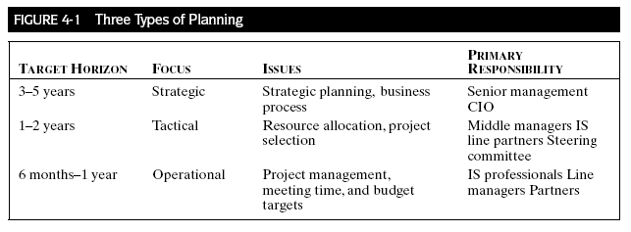
Levels of Planning

Slide 140
Why Planning Is So Difficult
Alignment of strategic business Goals and systems plans
CIO not in inner circle
Attitudes have changed
Technologies are rapidly changing
Is planning even relevant?
Continuous planning (monitoring, adjustments)
“Built to Change” (Lawler III & Worley, 2006)

Slide 141
Why Planning Is So Difficult
Companies need IT portfolios rather than projects
Portfolio planning is sophisticated
Projects must be evaluated beyond individual merits
Fit with other projects is crucial
Infrastructure development is difficult to fund
IT investments grossly expensive
Constant pressure to keep up with industry?

Slide 142
Why Planning Is So Difficult
Responsibility needs to be joint
Commitment from multiple stakeholders
Can extend organizational boundaries
Other planning issues
Organizational culture
Top-down versus bottom-up
Piecemeal versus Integrated change

Slide 143
The Changing World of Planning
Evolution of strategic IS planning along with rapid change of Internet-driven technologies.
Traditional style of planning no longer viable
Command and control
IS as a support function
“Lifecycle” (static environment)
Still need long-range vision but with flexibility and creativity

Slide 144
Traditional IS Planning
Source: Adapted from and reprinted with permission from Roger Woolfe, Barbara McNurlin, and Phil Taylor, Tactical Strategy, Wentworth Research Program (now part of Gartner EXP, 56 Top Gallant, Stamford, CT 06904), November 1999.

Slide 145
The Changing World of Planning cont’d
The future is less predictable
Disruptive Internet-driven innovations (e.g. Amazon.com)
Time is running out
Speed is of the essence
IS does not just support the business anymore
How can IT influence new ways of working?

Slide 146
The Changing World of Planning cont’d
Top management may not know best
Need a shift in planning approach from “inside-out” to “outside-in” (Fig. 4-3)
Start with the customers and front-line employees
A business organization is not like an army
Sense-and-respond approach (Fig. 4-4)
Let strategies unfold rather than plan them
Deng Xiaoping’s words of wisdom
Step by step; agility; heuristics

Slide 147
Outside-In versus Inside-out
FIGURE 4-3 Outside In
Strategy Development
Source: Adapted from and reprinted with permission from Roger Woolfe, Barbara McNurlin, and Phil Taylor, Tactical Strategy, Wentworth Research Program (now part of Gartner EXP, 56 Top Gallant, Stamford, CT 06904), November 1999.

Slide 148
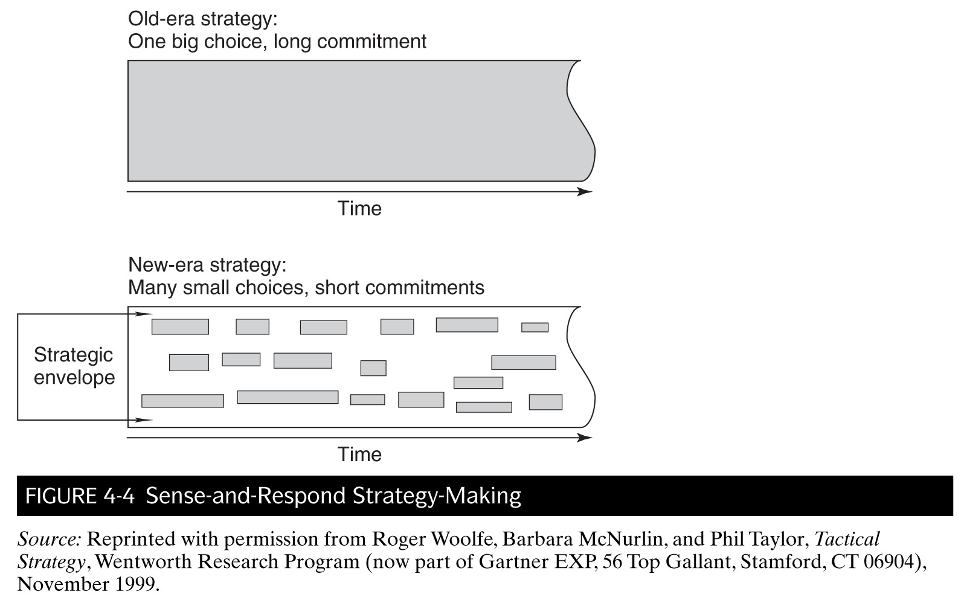
Sense-and-Respond Approach

Slide 149
Microsoft
Case example: Sense-and-Respond
Diversification and expansion strategy
Relentlessly explore different software technologies and business opportunities
Always an eye on the competitive environment
Windows and PC, MSN portal, mobile devices and apps, Xbox, business solutions etc.
Latest challenge (February 2008): Bid $44.6 billion for Yahoo! to compete with Google

Slide 150
The Changing World of Planning cont’d
Formulate strategies closest to the action
Strategic development should start from the “organizational edges” (front line)
Outside-in approach

Slide 151
Skandia Future Centers
Case example: Strategic development closest to the action
3G teams (25+, 35+, 45+)
Debates, dialogs (acted out in theatre plays)
Knowledge Café
“Cocktail party” style of discussion about plays
Entire process video recorded
Nurturing Project Portfolio
Gardening as a metaphor
Notes:
Skandia Future Centers
An incubator for testing ideas on IT social relationships, and networking for holding company 150-year-old financial service Skandia Group

Slide 152
The Changing World of Planning cont’d
Guide strategy making with a “strategic envelope”
Myriad of strategic options and opinions (especially with outside-in approach)
Need central guidelines from top management to prevent anarchy
Set parameters
Open and regular communication

Slide 153
Shell Oil
Case example: “Strategic Envelope”
New GM believed in outside-in, grassroots approach of strategy development
Action Labs
Team retailing bootcamps (business proposals)
develop, critique, refine, funding (or not)
Results
Unfreezing status quo (flatter organization)
Innovation (staff more energized)

Slide 154
Eight Planning Techniques
Useful to have a framework or methodology to help in the complexities of IS planning
Eight different techniques have been proposed over the years

Slide 155
1. Stages of Growth
Stage 1: Early successes (adoption)
Success in initial use of new technology leads to increased interest and experimentation
Stage 2: Contagion
Proliferation of technology stage of “learning” for the field—what worked, what did not etc. (feedback)
Stage 3: Control
Efforts toward standardization after proliferation
Stage 4: Integration (mature phase)
Pattern is repeated for newer technologies

Slide 156
Stages of Growth
Notes:
DP: Data processing era
Micro: PC era
Network: Internet era
Key function of Stages Framework is to help in the understanding where the technology resides on the organizational learning curve, which effect IS policies.

Slide 157
2. Critical Success Factors
What are the few key areas of the job where things must go right for the organization to thrive?
Four sources for CSFs
Industry business is in (specific)
Company itself and situation within industry
Environment (e.g. consumer trends)
Temporal organizational factors
Notes:
Temporal organizational factors: areas of activities that normally do not warrant concern but are currently unacceptable and require attention.

Slide 158
3. Competitive Forces Model
Porter’s Five Forces (to determine suitability of industry)
Threat of new entrants
Bargaining power of customers
Bargaining power of suppliers
Substitutes
Competition (intensity)
Notes:
Temporal organizational factors: areas of activities that normally do not warrant concern but are currently unacceptable and require attention.

Slide 159
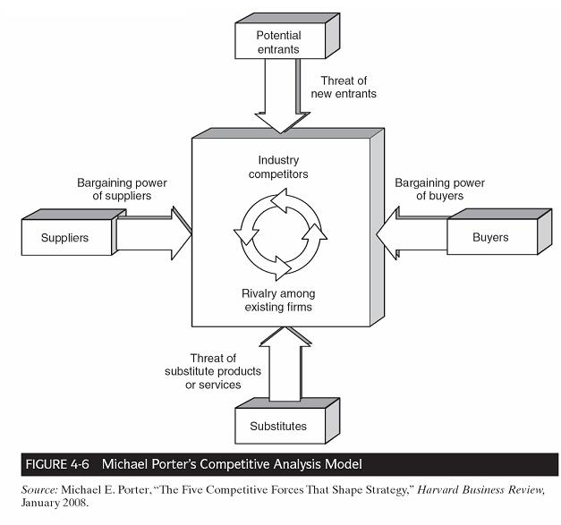
3. Porter’s Five Forces

Slide 160
3. Competitive Forces Model
Three strategies for dealing with these competitive forces
Product differentiation
Price leadership (lowest cost)
Niche market (could be geographical or segment)

Slide 161
3. Framework Example
Internet tends to reduce firms’ profitability
Five Forces analysis of the Internet (impact)
Increases buyer power (lower search costs)
Decreases barriers to entry
Increases bargaining power of suppliers
Increases the threat of substitute products
Intensifies rivalry among competitors (how?)
Internet Strategy: Focus on maintaining profitability (not growth and market share)
Discuss with regard to Amazon.com (“Get Big Fast”)
Notes:
The Internet is not an industry!
Five Forces Analysis to help determine entry into a particular industry.

Slide 162
4. Downes’ Three Emerging Forces
Porter’s Five Forces model is rooted in industrial organization, which reflects an era of rather predictable developments
Three “new” forces:
Digitization (new business models)
Globalization (telecommunications, transportation)
Deregulation (many industries)
Strategy planning in the “new economy” is less stable

Slide 163
5. Porter’s Value Chain Analysis
Five primary activities that form the sequence of the value chain:
Inbound logistics
Operations
Outbound logistics
Marketing and sales
Service
Notes:
Receiving and handling inputs
2. Converting inputs into products and services
3. Collect, store and distribute the product/service to customers
4. The means/incentives for customers to buy the product/service
5. Enhancement/maintenance of the value of the product/service

Slide 164
5. Porter’s Value Chain Analysis cont’d
Four supporting activities that underlie the entire value chain:
Organizational infrastructure
Human resources management
Technology development
Procurement

Slide 165
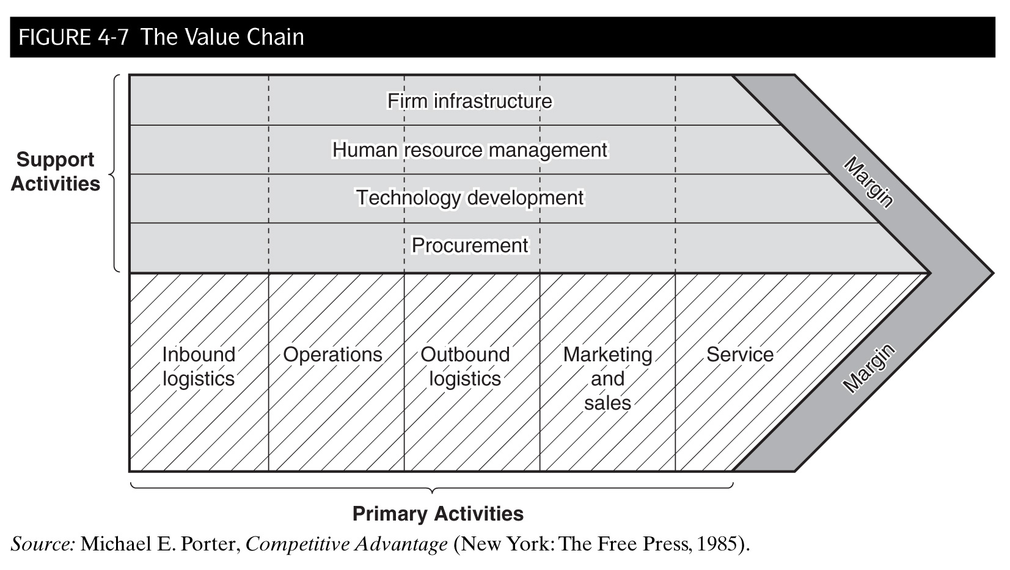
5. Porter’s Value Chain Analysis cont’d

Slide 166
5. Porter’s Virtual Value Chain Extended
How can companies create value in the Internet marketplace (e-commerce)?
Information as a source of value itself, rather than a support element. Five ways:
Gather
Organize
Select
Synthesize
Distribute

Slide 167
An Automobile Manufacturer
Case Example: Virtual Value Chain
Rental car subsidiary auction off good used cars to dealers online via satellite dish networks
Dealers view cars and place bids during online auctions.
Faster sales; time and effort saved
Which way(s) was information used to create business value?

Slide 168
6. E-Business Value Matrix
Tool used at Cisco Systems to develop a well-rounded portfolio of IT projects.
Every IT project is placed into one of four categories to assess its business value:
New fundamentals
Operational excellence
Rational experimentation
Breakthrough strategy
Notes:
Increase productivity; aimed at grassroots level (e.g. business via Internet)
Re-engineering work
Test new ideas and technologies
Potentially huge impact on business if a success

Slide 169
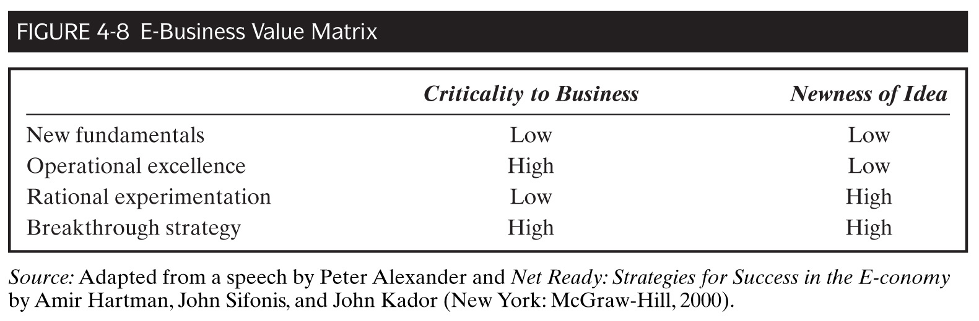
6. E-Business Value Matrix

Slide 170
Cisco Systems
Case Example: E-Business Value Matrix
New fundamentals
Expense reporting system via the Web
Operational excellence
Executive dashboards (DSS)
Rational experiment
Multi-cast streaming video for company meetings (IP TV)
Breakthrough strategy
Development of virtual supply chain (only 5 of 26 factories owned)

Slide 171
7. Linkage Analysis Planning
Examines the links between organizations in order to create a strategy for utilizing electronic channels
Methodology involves three steps
Define power relationships among stakeholders
Map out the extended enterprise (suppliers, buyers, strategic partners)
Plan electronic channels to deliver information component of products and services

Slide 172
7. Linkage Analysis Planning cont’d

Slide 173
Electric Power Research Institute
Case Example: Linkage Analysis Planning
Business: commercialize basic energy-type research
Mission: maximize the efficiency of the process (from input to output)
EPRINET (online system): identify services and products that would offer strategic business advantages to members
Online information
Expert system-based products
Email facilities (person-to-person)
Video-conferencing (small group)

Slide 174
EPRINET

Slide 175
8. Scenario Planning
Goal is to 1) explore the forces that could cause different “scenarios” of the future to happen; and 2) take proactive actions against those scenarios
Departs from traditional long-range planning based on hindsight
Four steps involved
Define a decision problem and time frame to bound the analysis
Identify the major known trends that will affect the decision problem
Identify just a few driving uncertainties
Construct the scenarios

Slide 176
Scenarios on the Future of IS Management
Case Example: Scenario Planning
Firewall Scenario
Information security and control main concerns
IS staff become general contractors and enforcement agencies
Worknet Enterprise Scenario
IT-enabled value networks
Self-managing virtual IS departments
IS staff as change agents of information brokers

Slide 177
Scenarios on the Future of IS Management cont’d
Case Example: Scenario Planning
Body Electric Scenario
IT products/services as commodities
IS function in “value-questing” (search for appropriate IT) and “IT facilitation” (adoption of new IT)
Tecknowledgy Scenario
Knowware (knowledge sharing as SCA)
IS function chiefly in facilitation and maintenance

Slide 178
What have we learned?
Be at the table
IS involvement in strategic planning
Test the future
Test-bed innovative IT projects (require seed funding)
Put infrastructure in place
Fundamentals and implementation is crucial
Guiding frameworks

Slide 179
Distributed Systems: The Overall Architecture
Chapter 5
Information Systems Management in Practice
8th Edition

Slide 180
Chapter 5
Describes basic forms of distributed systems
Attributes
Types
Discusses importance of IT architecture and infrastructure from management point of view.

Slide 181
Today’s Lecture
Introduction
Attributes of Enterprise Distributed Systems
Corporate Policy for Distributed Computing
Two Guiding Frameworks

Slide 182
Today’s Lecture cont’d
Types of Enterprise Distributed Systems
Host-based Hierarchy
Decentralized Stand-Alone Systems
Peer-to-Peer LAN-Based Systems
Hybrid Enterprise-Wide Systems
Client-server Systems
Internet-Based Computing
Web Services

Slide 183
Today’s Lecture cont’d
Defining The Overall IT Architecture
Enterprise Architecture Framework
Service-Oriented Framework

Slide 184
Today’s Lecture cont’d
Inter-Organizational IT Architecture and Digital Society
Structure of IT Infrastructure
Three Views of Infrastructure
Digital Economy
Corporate Infrastructure in the Digital Economy

Slide 185
Introduction
IT architecture versus IT infrastructure
Architecture (conceptual)
Blueprint
Infrastructure (physical)
Implementation (hardware, software, networks)
Evolution of Distributed Systems
Mainframe → Client-server → Web
What do you think: evolutionary or cyclical?

Slide 186
Attributes of Distributed Systems
Degree to which a system is distributed is dependent on:
Where the processing is done
Spread out the workload to other machines
Requires system interoperability
How processors and other devices are interconnected
Redundancy (at least one alternative route)

Slide 187
Attributes of Distributed Systems cont’d
Where the information is stored
Distributed databases without duplication
Similar to OSI model of data transmission
What rules or standards are used
Need system-wide rules
Technical (if-then-else)
Management (e.g. security)

Slide 188
Corporate Policy for Distributed Computing
IS has to decide when and to what degree computing at the corporate level should be distributed.
Hardware, software, networking, processing, storage
Onus should not be placed on individual end users and departments

Slide 189
Corporate Policy for Distributed Computing cont’d
Rule of Thumb: Systems responsibilities should be distributed unless:
Operations are interdependent (ERP)
Businesses are homogeneous
Corporate culture does not support decentralization (not aligned)

Slide 190
Types of Enterprise Distributed Systems
Host-based Hierarchy
Master-slave architecture
Decentralized Stand-Alone Systems
“Islands of Computing” (not distributed really)
Peer-to-Peer LAN-Based Systems
No hierarchy or ‘superior’ computer
Hybrid Enterprise-Wide Systems
Combination hierarchy (mainframe connected to a few departmental level LANs via WANs)

Slide 191
Host-Based Hierarchy

Slide 192
Decentralized Stand-Alone Systems

Slide 193
Peer-to-Peer LAN-Based Systems

Slide 194
Hybrid Enterprise-Wide Systems

Slide 195
Types of Enterprise Distributed Systems cont’d
Client-Server Systems
Splits computing workload between client and server (e.g. Lotus Notes)
(P)resentation
(A)pplication
(D)ata
Three-tier architecture (another way to look at it)

Slide 196
Client-Server Computing

Slide 197
Client-Server Arrangements

Slide 198
An Aerospace Company
Case example: Client-Server Systems
Client-server system
Application code on clients
Data on servers (remote management)
Communication Middleware between them
Data repository is key (metadata)
Object-oriented computing
Distributed function minimizes costs

Slide 199
An Aerospace Company cont’d

Slide 200
Benefits & Drawbacks of Client-Server Systems
Benefits
Increases organizational flexibility
System scalability
Front-end empowerment (decision-making)
Drawbacks
No cost differential (with regard to mainframe systems)
IS job more complex
Notes:
Add more nodes without much disruption to entire computing system
Does not have to go through corporate server

Slide 201
Types of Enterprise Distributed Systems cont’d
Internet-Based Computing
Extension of client-server (via Internet)
Software updates
Java Web applets
(Toward) Thin Clients
Requisite for ubiquitous computing
New ways of doing business

Slide 202
IBM, Nokia and Sabre Project: Pervasive Computing
Case example: Internet-Based Computing
Real-time interactive travel services provided via the mobile phone using WAP.
XML
Connect Sabre’s online traveling system to Nokia’s wireless network and Internet-enabled phones.
Java applets
Deliver applications over Internet
WML:
Present XML information to mobile device

Slide 203
Types of Internet-Based Computing
Server-based Computing (Thinner Client)
Mobile workers and laptops
Software update difficulties
Data security
Applications and sensitive data reside on server
e.g. Citrix Server (remote desktop)
Easier management
Lower cost

Slide 204
3i
Case Example: Server-Based Computing (mobile)
“Anytime, Anywhere” access to systems for investment professionals
Up-to-date information
Connect to Citrix server (application) over the Internet using secure modem service (VPN)
Arrangement allows for global expansion
Offices in 14 countries (2007)

Slide 205
Types of Internet-Based Computing
Peer-to-Peer Computing (P2P)
Task distributed to wide number of computers (peers) connected over the Internet
Grassroots movement, first popularized by Napster
Economics: How to make money?
Subscriptions for access

Slide 206
Types of Enterprise Distributed Systems cont’d
Web Services (Web-based SaaS)
Second-generation Internet-based distributed system
URLs embedded in software modules
e.g. Google Apps, SalesForce
Computer-to-computer use of the Internet (based on object-oriented tenets)
Future: “cloud computing” (Internet as hub)
“In-house” computing a thing of the past

Slide 207
Web Services Standards
Three software standards
XML
WSDL
UDDI
Three communication standards
SOAP
HTTP
TCP/IP

Slide 208
Significance of Web Services
How does it impact business and work?
From proprietary IT architecture to Web Services based on openness of Internet
Faster market response
Hugh variety of possibilities
Pay only for needed functionality

Slide 209
General Motors
Case Example: Web Services
Build-to-stock → Build-to-order
Locate-to-order Web service
Order-to-delivery (precursor of make-to-order)
Rewards?
Cut $25 billion inventory by 50%
Potentially shave off $1,000 off the cost of each vehicle…How?

Slide 210
Defining the Overall IT Architecture
Helps in the management of complex information systems
Supports firm operations and therefore reflects business strategy
Needs to keep pace with business change
Chief Technology Officer at the helm

Slide 211
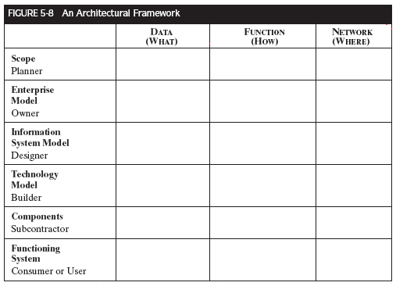
An Enterprise Architecture Framework (template)
Source: Adapted from John Zachman, Zachman International, 2222 Foothill Blvd., Suite 337, LaCanada, CA 91011.

Slide 212
An Enterprise Architecture Framework (whole picture)

Slide 213
FMC Corporation
Case Example: IT Architecture Development
Conglomerate split into half
IT Architecture had to be redesigned…how?
“today architecture”
“tomorrow architecture”
“next-minute steps”
IT architecture understood by all stakeholders
Standard-setting easier
New architecture for VoIP and Web Services

Slide 214
Service-Oriented Architecture
SOA a form of distributed computing
Similar architecture concept to Web Services
Can be implemented with Web Services
Thinks about how to expose the data and functions in a way that other systems can easily use (e.g. XML)
“Killer app” that has eluded IS organization?
More nimble

Slide 215
Credit Suisse
Case Example: Service Oriented Architecture
Proprietary middleware → SOA
Implemented two “information buses”
Service Bus
Integrates front-end and back-end applications based on demand-pull model
Event Bus
Integrates back-end systems, ensuring all systems (host applications, ERP systems, databases, etc) are using the same up-to-date data

Slide 216
Inter-Organizational Architecture and Digital Society

Slide 217
The Structure of the IT Infrastructure
What is an IT infrastructure?
The shared and reliable services that provide the foundation for enterprise IT portfolio.
Four layers of IT infrastructure
Technical component
Human IT
Shared IT services
Shared and standard applications
Needed but not directly linked to business value
Enables other systems
Links to external industry infrastructure

Slide 218
The Structure of the IT Infrastructure

Slide 219
The Structure of the IT Infrastructure

Slide 220
Three Views of IT Infrastructure
Benefits realization depends on objectives for the IT infrastructure
Economies of scale (utility)
Necessary and unavoidable
Support for business programs (dependent)
Ties infrastructure investments to specific business programs
Flexibility to meet changes in the marketplace (enabling)
IT-business alignment (strategic)

Slide 221
The Digital Economy
New business models, new products and services, new communication means, and new forms of community.
Evolution of digital economy in 3 phases
Data processing revolutionized
Wide variety of electronic devices because of Moore’s Law and decreasing costs
Exponential growth of electronic commerce

Slide 222
Corporate Infrastructure in the Digital Economy
Leverage Internet-enabled technologies to support business strategy in the digital economy
Extended enterprise
Value network
Strategic alliance
Value network
Virtual Organization
Globally distributed work

Slide 223
Conclusion
Internet now at heart of distributed systems paradigm (Web services)
Distributed systems extend outside of organization because of the Internet
Effective implementation of distributed systems architecture requires top management commitment, realistic budgeting and strong project management

